Slide 1

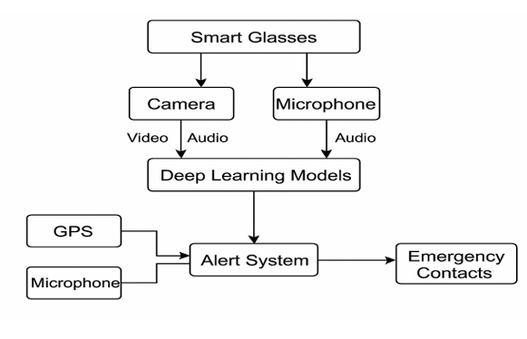
Deep Learning Based Smart Glasses For Women Safety
Batch No: 16 Division: B SRNs:02fe21bec080,02fe21bec083,02fe21bec100,02fe21bec105
Student Names: Sakshi B, Samruddhi V S, Srushti P, Ujwala V T Guide:prof. S M Hunagund
Context: This project introduces a smart glasses-based system that uses video, audio, and GPS data to detect emergencies in real time. Deep learning models analyze inputs from the built-in camera and microphone to identify distress events. When detected, the alert system instantly notifies emergency contacts with location and audio details, enabling quick response and enhanced personal safety.
Problem Statement: Women’s safety is a major concern, especially in isolated areas or at night. Current solutions need manual activation and fail without internet. An AI-powered smart glasses system can automatically detect threats, record evidence, and send alerts—ensuring faster response and greater protection.
Deliverables :
Smart glasses prototype
Emergency detection model
Drivable
Training / Pre-Requisites
Understanding of machine learning algorithms, Python,Open CV.
Timeline
Starter Reference Material
S. Kaur, R. Sharma, and A. Verma, ”Deep learning-enabled smart glasses for real time women safety monitoring,” IEEE Access, vol. 9, pp. 123456-123465, 2021.
M. Patel and S. Desai, ”AI-based wearable devices: A study on smart glasses for women safety,” International Journal of Artificial Intelligence and Applications, vol.11, no. 3, pp. 22-31, 2020.
P. Chowdhury et al., ”Deep neural network approaches in smart wearable technology for women security,” Sensors, vol. 22, no. 5, 2022.
A. Gupta and V. Singh, ”Design and development of AI-powered smart eyewear for ensuring women’s safety,” Journal of Intelligent Robotic Systems, vol. 108, no. 2, 2023.
Kick Off < 1st Month >
Milestone 1 < 2nd Month >
Milestone 2 < 3rd & 4th Month
Training and Initial Testing
Testing, retuning, validation
Documentation
Hands on learning with pre-trained Available Dataset
Learning Machine learning tools and algorithms

